Slide 1
AWS– Amazon Web Services

Slide 2
AGENDA
What is cloud computing
Cloud deployment model
Types of services model
What is AWS
What is the Global Infrastructure
EC2 Instance Demo session

Slide 3
What is Cloud Computing
It’s the On-Demand Delivery of the IT Resource like that Compute, RAM, Storage, Application etc.. Through a Cloud service platform (AWS)via the internet with pay-as-you go pricing.
Cloud service Platform
AWS owned by Amazon ---My platform is AWS
Azure Owned by Microsoft
GCP owned by Google

Slide 4
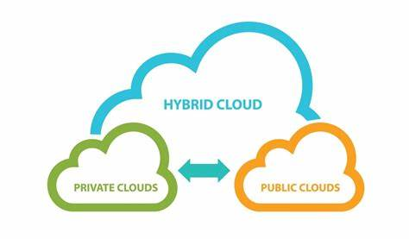
Cloud deployment model
There are 3 type are given below
Public
Private
Hybrid

Slide 5
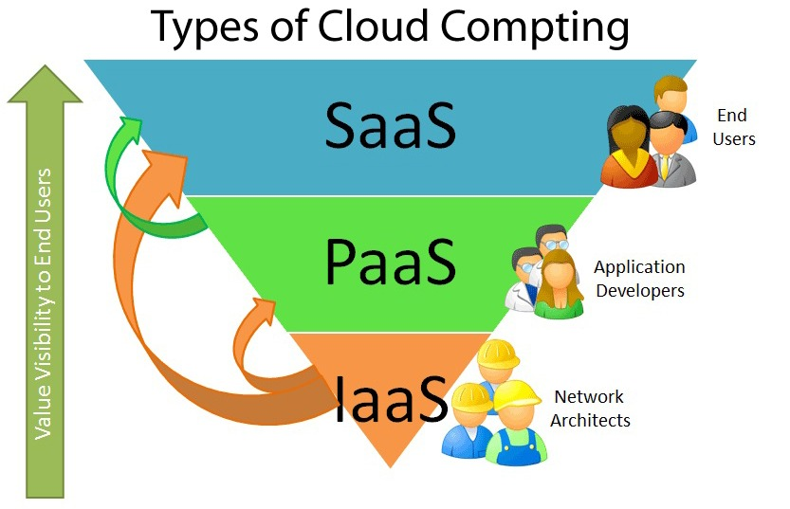
Types of Services Model
There are 3 types in the service model
IAAS--- infrastructure as a service
PAAS--- platform as a service
SAAS--- software as a service

Slide 6
What is AWS
Is the subsidiary of amazon.com that provide on-demand cloud computing platform to individuals, companies and government on a paid subscription basis with a free tier options available for 12 months.

Slide 7
AWS
AWS (Amazon Web Services) is a comprehensive, evolving cloud computing platform. Its provided by Amazon that includes a mixture of infrastructure as a service (IaaS), platform as a service (PaaS) and packaged software as a service (SaaS) offerings.
Example:
IAAS: EC2
PAAS: Elastic Beanstalk
Saas:Gmail

Slide 8
AWS Global Infrastructure Map
https://aws.amazon.com/about-aws/global-infrastructure/

Slide 9
Region & AZ & Edge Location
Region: A set of datacenters deployed within a latency-defined perimeter and connected through a dedicated regional low-latency network
Availability Zone: Unique physical locations within a region. Each zone is made up of one or more datacenters equipped with independent power, cooling, and networking.
Edge Location: is where end users access services located at AWS. They are located in most of the major cities around the world and are specifically used by Cloud Front (CDN) to distribute content to end user to reduce latency.

Slide 10
How to create the AWS free account

Slide 11
Demo: EC2- Instance
EC2 -- Elastic Compute Cloud (Amazon EC2)
its a web-based service that allows businesses to run application programs in the Amazon Web Services (AWS) public cloud

Slide 12
Load Balance --(ELB)
Load Balance is called the Elastic Load balance in the AWS.
Load balances are servers that forward the internet traffic to multiple servers (EC2 instance) down stream.
Its reduces the traffic in the servers
Do regular health check to your EC2 instance.
There are 3 types in the ELB
1. classic LB
2. Application LB
3. Network LB

Slide 13
Demo Session of the Load balance

Slide 14
AUTO SCALING
Is a service which helps users to monitor application & automatically adjusts capacity to maintain steady predictable performance at the lowest possible cost.

Slide 15
Demo Session of the Auto Scaling

